Slide 1
Title
Project Name : Smart Study Focus Tracker
Team Leader Name: Shivani Nikam
Team Member : 1) Rupali Korhale
2) Sairam Khatri
College Name: Padmbhushan Vasantdada Institute Of Technology Bavdhan ,Pune
Academic Year: 2025-26
Department Name: Computor Engineering

Slide 2
Introduction
Time management is a critical factor in academic success
Students often struggle to maintain consistent focus during study sessions
Distractions such as mobile usage and social media reduce productivity
Lack of awareness about actual study time leads to inefficiency
There is a need for a simple system to monitor and improve study habits

Slide 3
Problem Statement
Students overestimate their productive study time
No proper system to track study vs break duration
Frequent interruptions reduce concentration
Lack of feedback on study performance
Existing tools are either complex or not student-friendly

Slide 4
Objective
To develop a simple system to track study and break time
To calculate a focus score based on user input
To classify focus levels (Low, Medium, High)
To provide immediate feedback for self-improvement
To create an easy-to-use interface for students

Slide 5
Proposed System
User inputs study time and break time
System processes input using rule-based logic
Calculates focus score
Displays categorized result (Low / Medium / High focus)
Provides warning for excessive breaks

Slide 6
Methodology
Input parameters:
Study Time (in minutes)
Break Time (in minutes)
Processing:
Focus Score = Study Time – Break Time
Rule-based classification applied
Output:
Focus Score
Feedback message
Warning (if break time is excessive)

Slide 7
System Architecture
User
Input
User Interface (Streamlit)
Input Module
Processing Module (Logic-based system)
Output Display
Processing
Output

Slide 8
Technology Used
Python: Core programming language
Streamlit: For building interactive UI
Rule-based logic: For quick decision-making

Slide 9
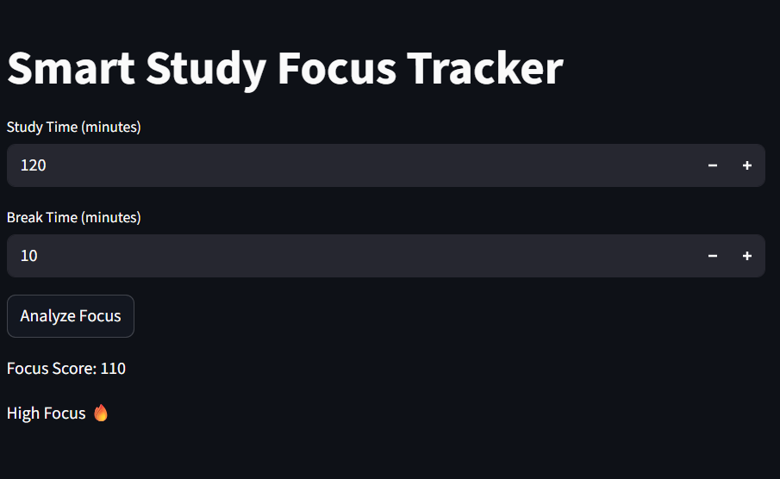
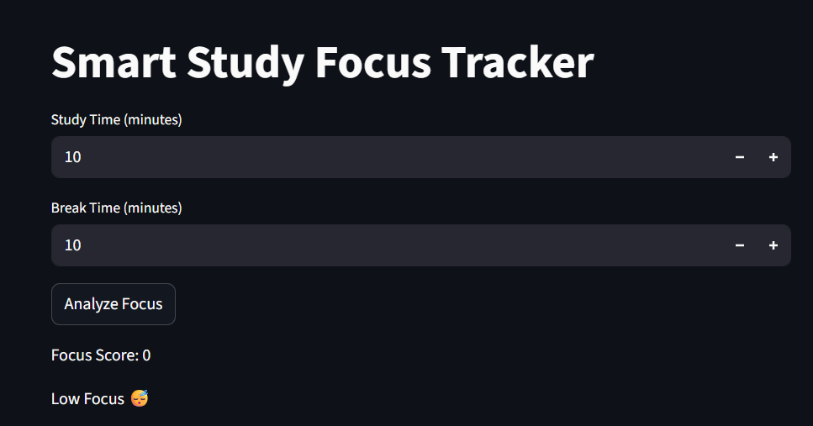
Output / Results
Displays calculated focus score
Provides categorized feedback instantly
Warns user about excessive break time
Simple and interactive interface

Slide 10
Advantages
Easy to understand and use
Fast processing with minimal input
Helps improve self-discipline
Lightweight and efficient system
Can be extended easily

Slide 11
Limitations
Depends on manual input
Does not track real-time behavior
Uses basic rule-based logic instead of ML
Limited personalization

Slide 12
Future Scope
Integration with mobile applications
AI/ML-based focus prediction
Real-time tracking using sensors or apps
Personalized study recommendations
Notification and reminder system

Slide 13
Conclusion
The system provides a simple way to evaluate study habits
Helps users become aware of their actual productivity
Encourages better time management
Can be enhanced into a smart productivity tool

Slide 14
Thank You
small improvements today lead to better outcomes tomorrow.

